Slide 1





AtliQ
Sales and Forecast Analysis
Project
This project aims to build a robust framework for
analyzing sales data and generating actionable insights to
improve AtliQ Hardware's operations.
Swathi Shetty

Slide 2
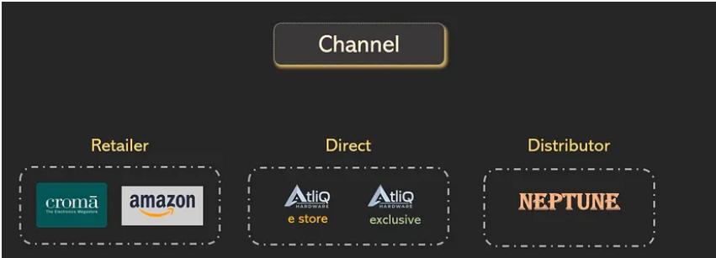
AtliQ Business Model:
• Atliq is a company that sells hardware gadgets to different customers like Croma, Best Buy, Amazon, Staples, Flipkart
• These customers/stores then sell the products to the end users
• Atliq has a manufacturing unit and supplies the hardware gadgets to customers across different countries
• Atliq uses two types of platforms to sell their products
• Atliq uses 3 main channels to sell their products:
Retailer
Direct via their own stores
Distributors

Slide 3
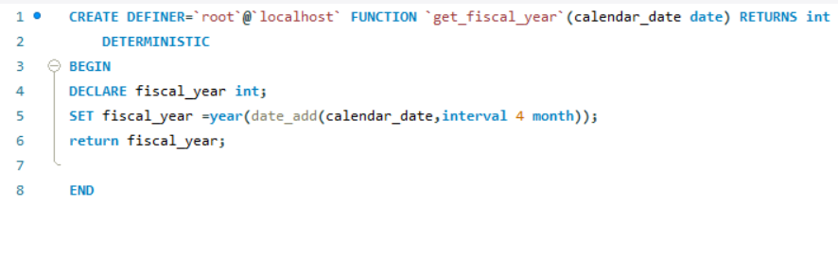
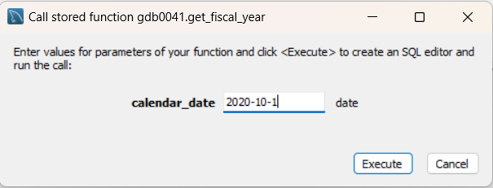
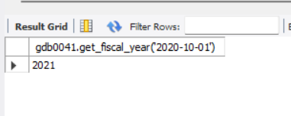
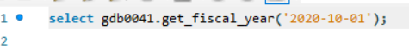
User defined Functions used :
User-defined functions in SQL are important because they allow for reusable, consistent logic to be applied across queries, improving code maintainability and efficiency.
get_fiscal_year :
The get_fiscal_year function calculates the fiscal year starting from September by adding 4 months to the given calendar_date and returning the year of the resulting date.

Slide 4
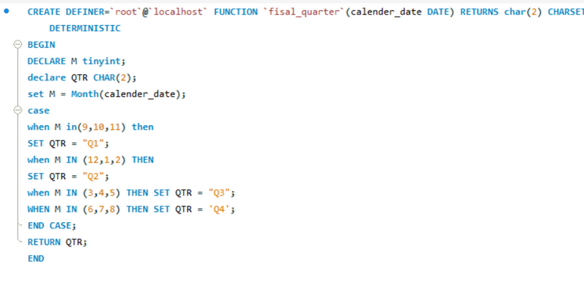
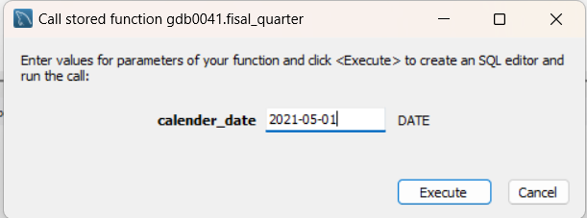
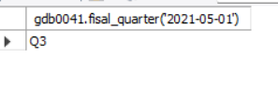
User defined Functions used :
User-defined functions in SQL are important because they allow for reusable, consistent logic to be applied across queries, improving code maintainability and efficiency.
2.get_fiscal_quarter :
The fiscal_quarter function determines the fiscal quarter (Q1 to Q4) based on the given calendar_date, assuming the fiscal year starts in September.

Slide 5
Stored Procedure
A stored procedure in SQL is a precompiled set of SQL statements that can be executed as a single unit, allowing for complex operations such as data manipulation and business logic. It enhances performance, promotes code reusability, and helps maintain data integrity by centralizing logic within the database.
Stored Procedures used in this project:
get_market_badge
get_monthly_gross_sales_report_customer
get_top_n_customer_by_net_sales
get_top_n_markets_by_net_sales
get_top_n_products_by_net_sales
get_forecast_accuracy

Slide 6
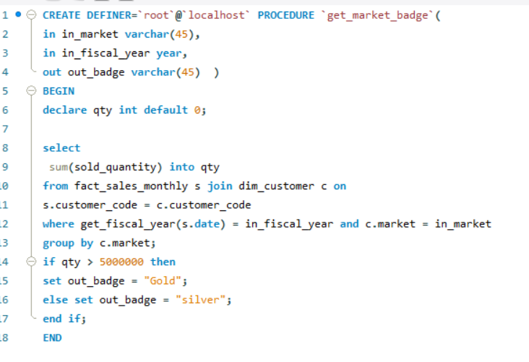
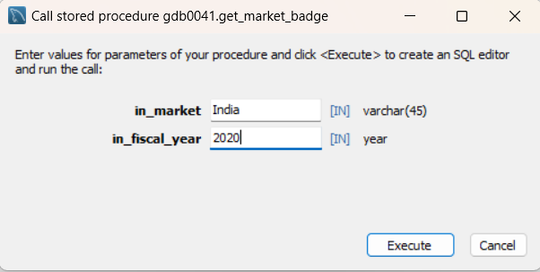
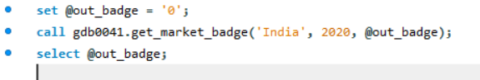
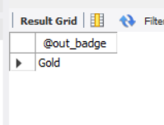
get_market_ badge

Slide 7
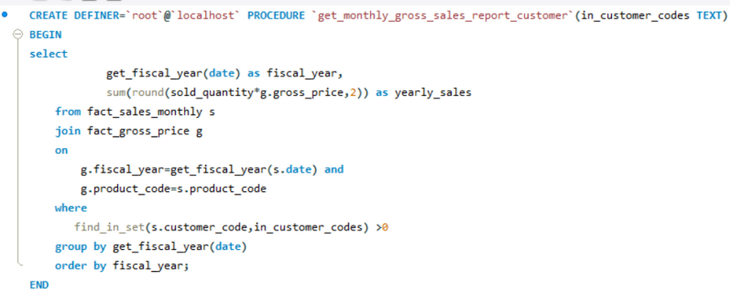
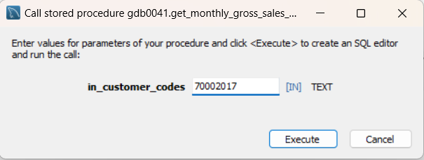
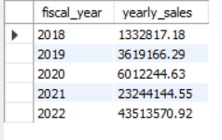
2. get_monthly_gross_sales_report_customer

Slide 8
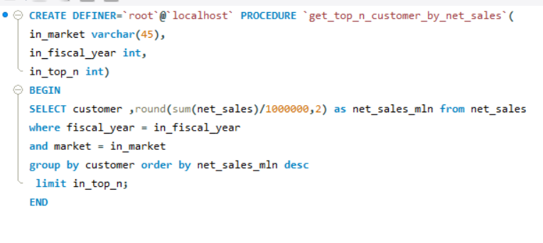
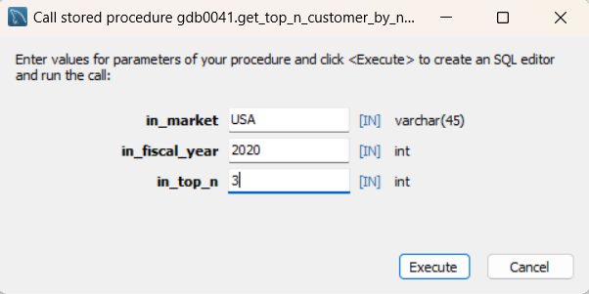
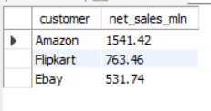
3.get_top_n_customer_by_net_sales

Slide 9
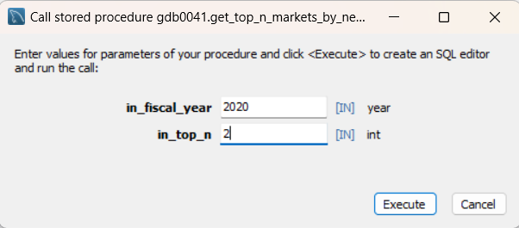
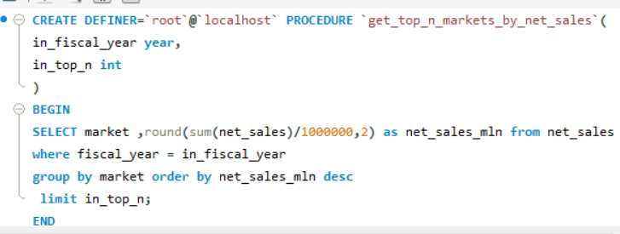
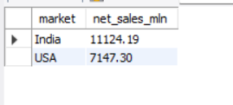
4. get_top_n_markets_by_net_sales

Slide 10
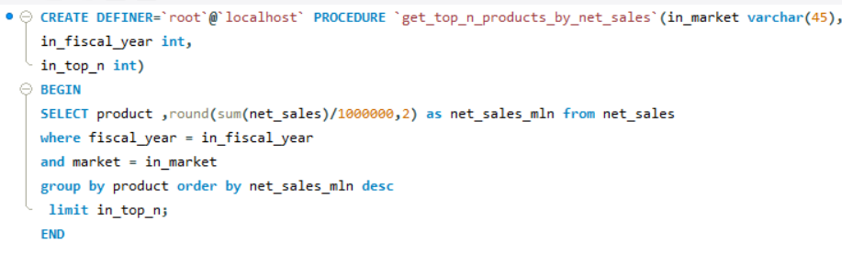
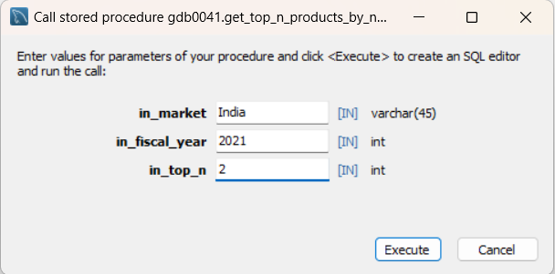
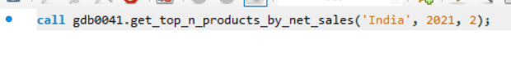
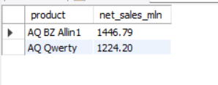
5. get_top_n_products_by_net_sales

Slide 11
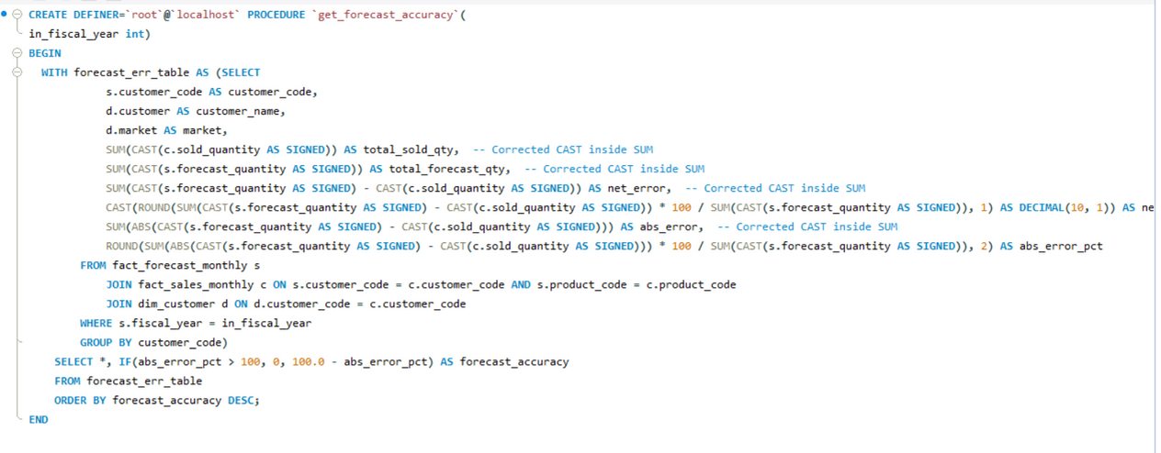
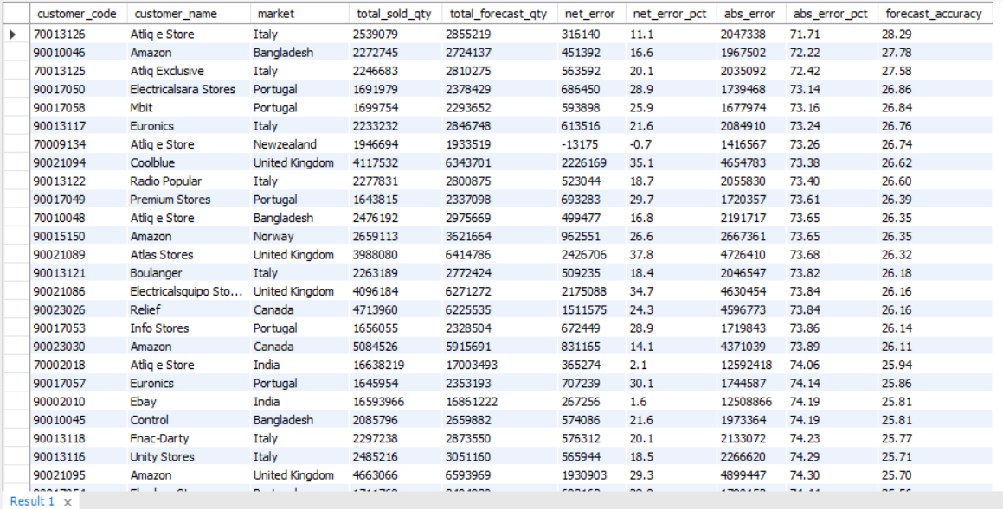
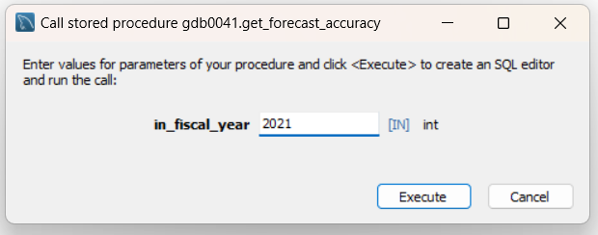
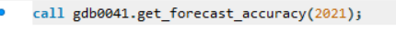
6. get_forecast_accuracy

Slide 12
Views
SQL views are virtual tables created from a SQL query that allow you to simplify complex queries, improve security by limiting access to specific data, and enhance data management efficiency. They do not store data themselves but provide a dynamic representation of the underlying data.
Views created in this project:
1.Gross sales
2.Net sales
3. Sales Pre invoice discount
3. Sales Post invoice discount

Slide 13
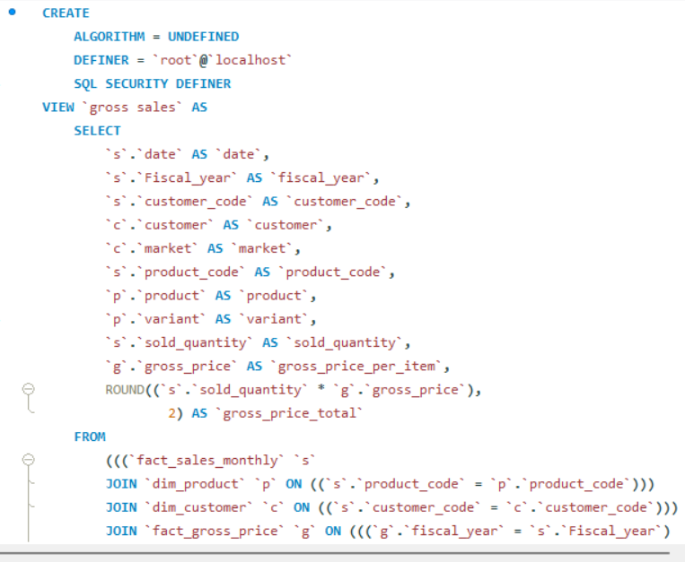
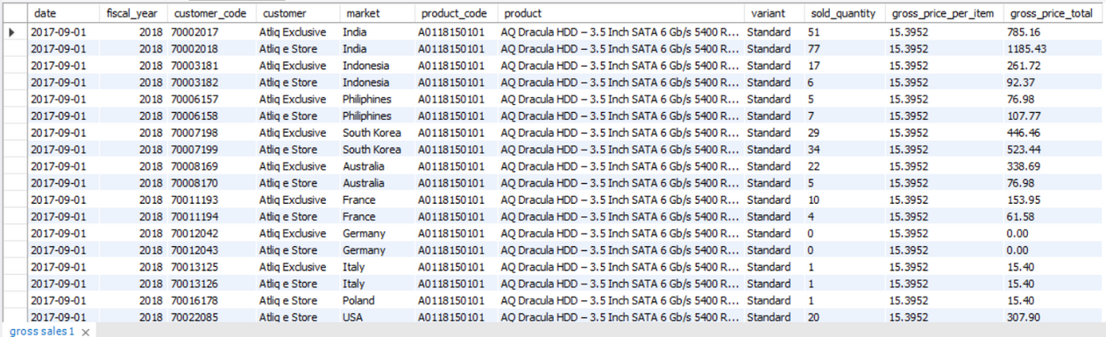
Views
1.Gross sales

Slide 14
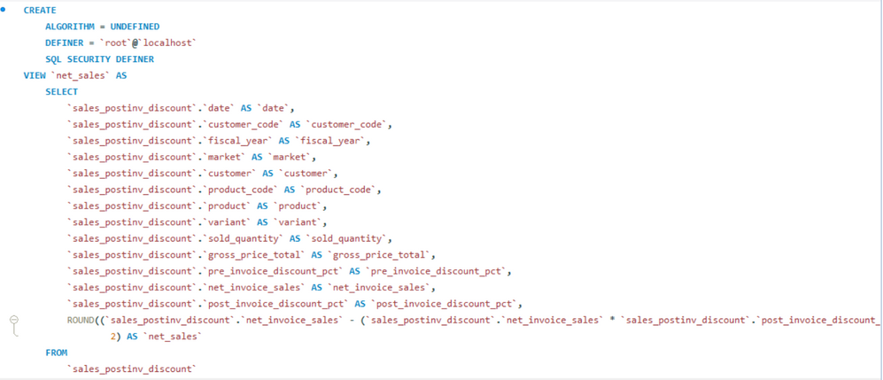
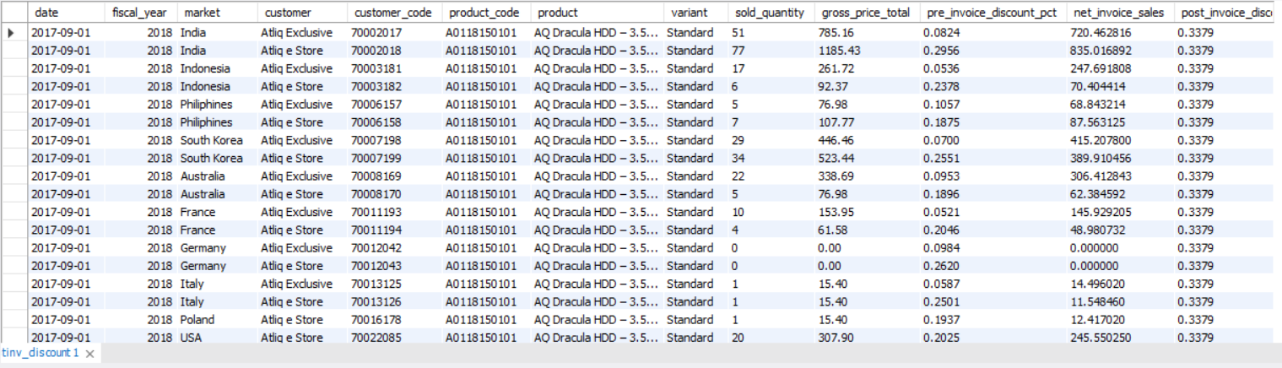
Views
2. Net sales

Slide 15
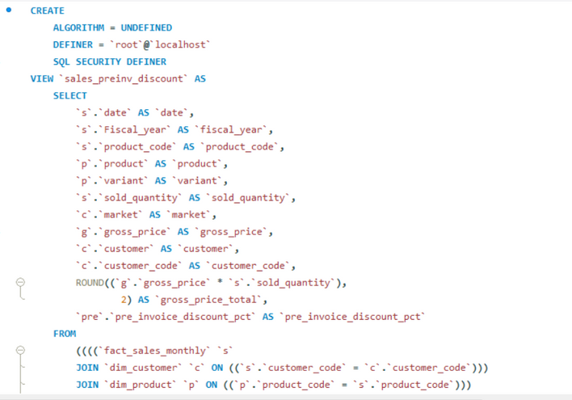
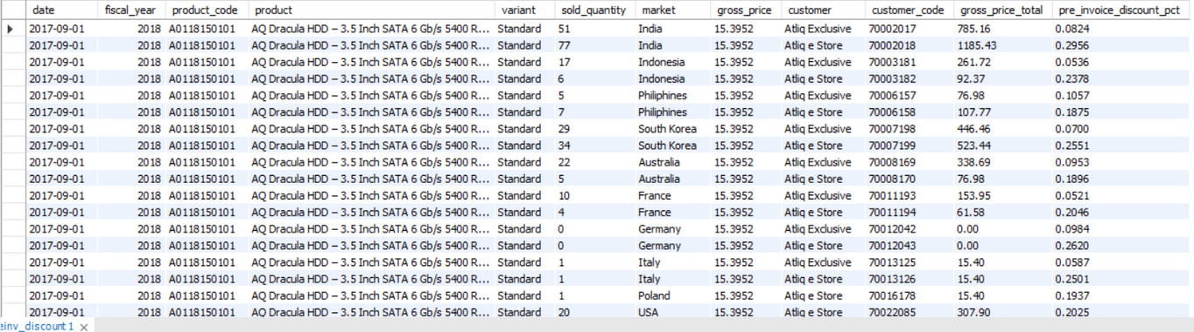
Views
3. sales pre invoice discount

Slide 16
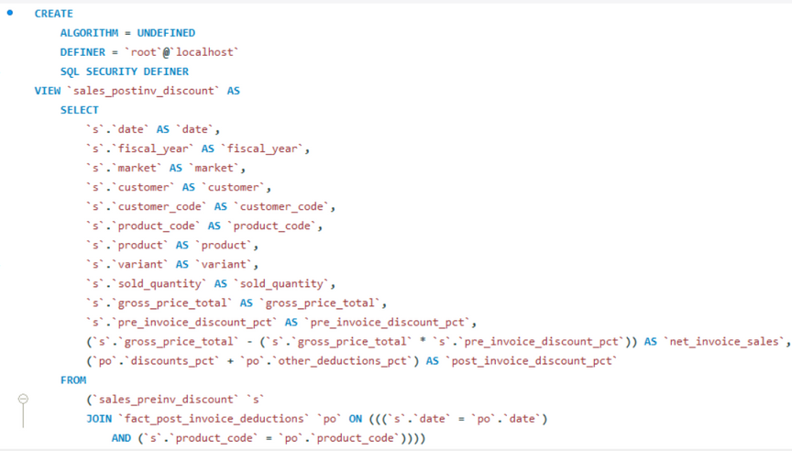
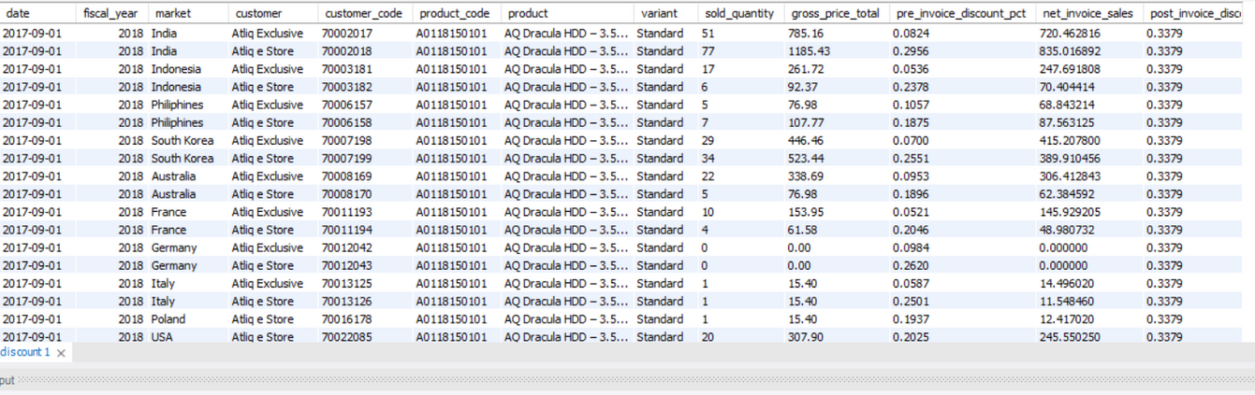
Views
4. sales post invoice discount

Slide 17
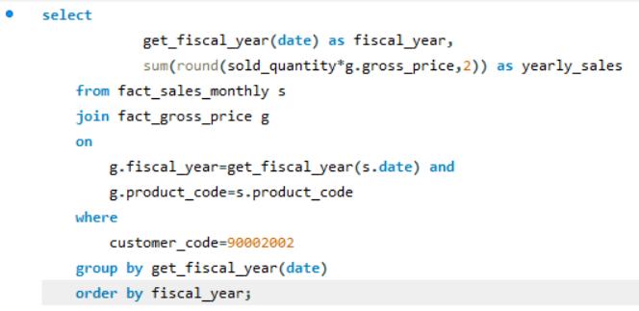
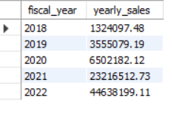
Problem statement 1
Generate a yearly report for Croma India where there are two columns
1. Fiscal Year
2. Total Gross Sales amount In that year from Croma

Slide 18
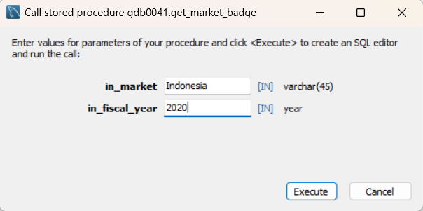
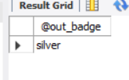
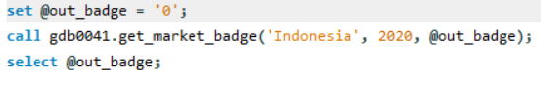
Problem Statement 2 :
Create a stored procedure that can determine the market badge based on the following logic if total sold quantity > 5 million that market is considered Gold Else it is Silver

Slide 19
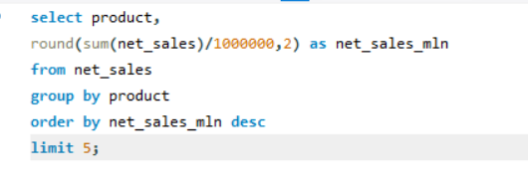
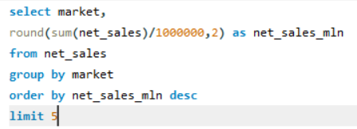
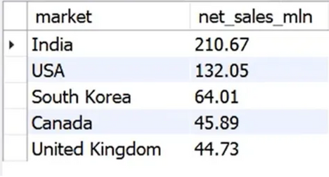
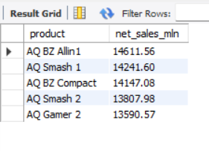
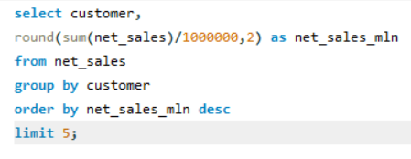
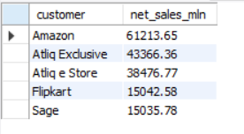
Problem Statement 3:
calculate these important KPI’s
Report on top 5 markets by net sales
Report on top 5 products by net sales
Report on top 5 customers by net sales

Slide 20
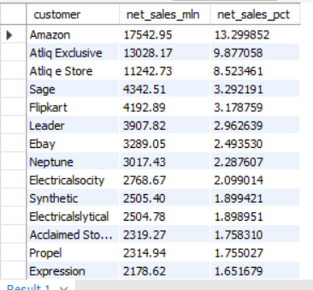
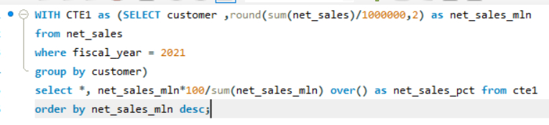

Problem Statement 4:
Prepare a bar chart report for FY =2021 for top 10 customers by % net sales to capture the global market share %

Slide 21






Problem Statement 5:
Prepare a pie chart for net sales% breakdown of customers but region wise( APAC, EU,LTAM ) to capture the global market share %

Slide 22


Problem Statement 6:
Get top n products in each division by their quantity sold

Slide 23
Problem Statement 7:
Generate Forecast Accuracy for all customers for a given fiscal year.

Slide 24
THANK YOU

